Slide 1

O’Reilly Architectural Kata 2023
Team Innovators
September 2023

Slide 2





Meet the Team
BIPLAB BANERJEE​​
SANDYA Shanmugham​​
ARAVIND ALURI
Abhijit Gangawane
Ragasree Paleti
Associate Director – Software Engineering
Manager – Software Engineering
Lead Software Engineer
Senior Software Engineer
Lead Software Engineer

Slide 3
Functional Requirements
Requirements
Poll email looking for travel-related emails
Filter and whitelist certain emails
The system must interface with the agency’s existing airline, hotel, and car rental interface system to update travel details (delays, cancellations, updates, gate changes, etc.). Updates must be in the app within 5 minutes of an update (better than the competition)
Customers should be able to add, update, or delete existing reservations manually as well.
Items in the dashboard should be able to be grouped by trip, and once the trip is complete, the items should automatically be removed from the dashboard.
Users should also be able to share their trip information by interfacing with standard social media sites or allowing targeted people to view your trip.
Richest user interface possible across all deployment platforms
Provide end-of-year summary reports for users with a wide range of metrics about their travel usage
Road Warrior gathers analytical data from users' trips for various purposes - travel trends, locations, airline and hotel vendor preferences, cancellation and update frequency, and so on.
Additional Context
must integrate seamlessly with existing travel systems (i.e., SABRE, APOLLO)
Must integrate with preferred travel agency for quick problem resolution (help me!)
must work internationally
Technical Requirements
Users must be able to access the system at all times (max 5 minutes per month of unplanned downtime
Travel updates must be presented in the app within 5 minutes of generation by the source
Response time from web (800ms) and mobile (First-contentful paint of under 1.4 sec)

Slide 4







The Road Warrior – Logical Architecture
Search Service
API Gateway
Machine-learning (ML) techniques are primarily used in various ways to improve the accuracy rate in detection, analysis, and prediction processes.
Hotels Service
Website
Cars Service
Frontends
Flights Service
Recommendation Engine
Mobile
Richest user interface possible across all deployment platforms
Booking Service
Event
Partner Service
Partners Domain
Customer Service
Updates the Hotels' database with availability, onboard new hotels, update prices, travel details (delays, cancellations, updates, gate changes, etc.)
Notification Service
Notification store
Near real-time notifications
Reporting Service

Slide 5
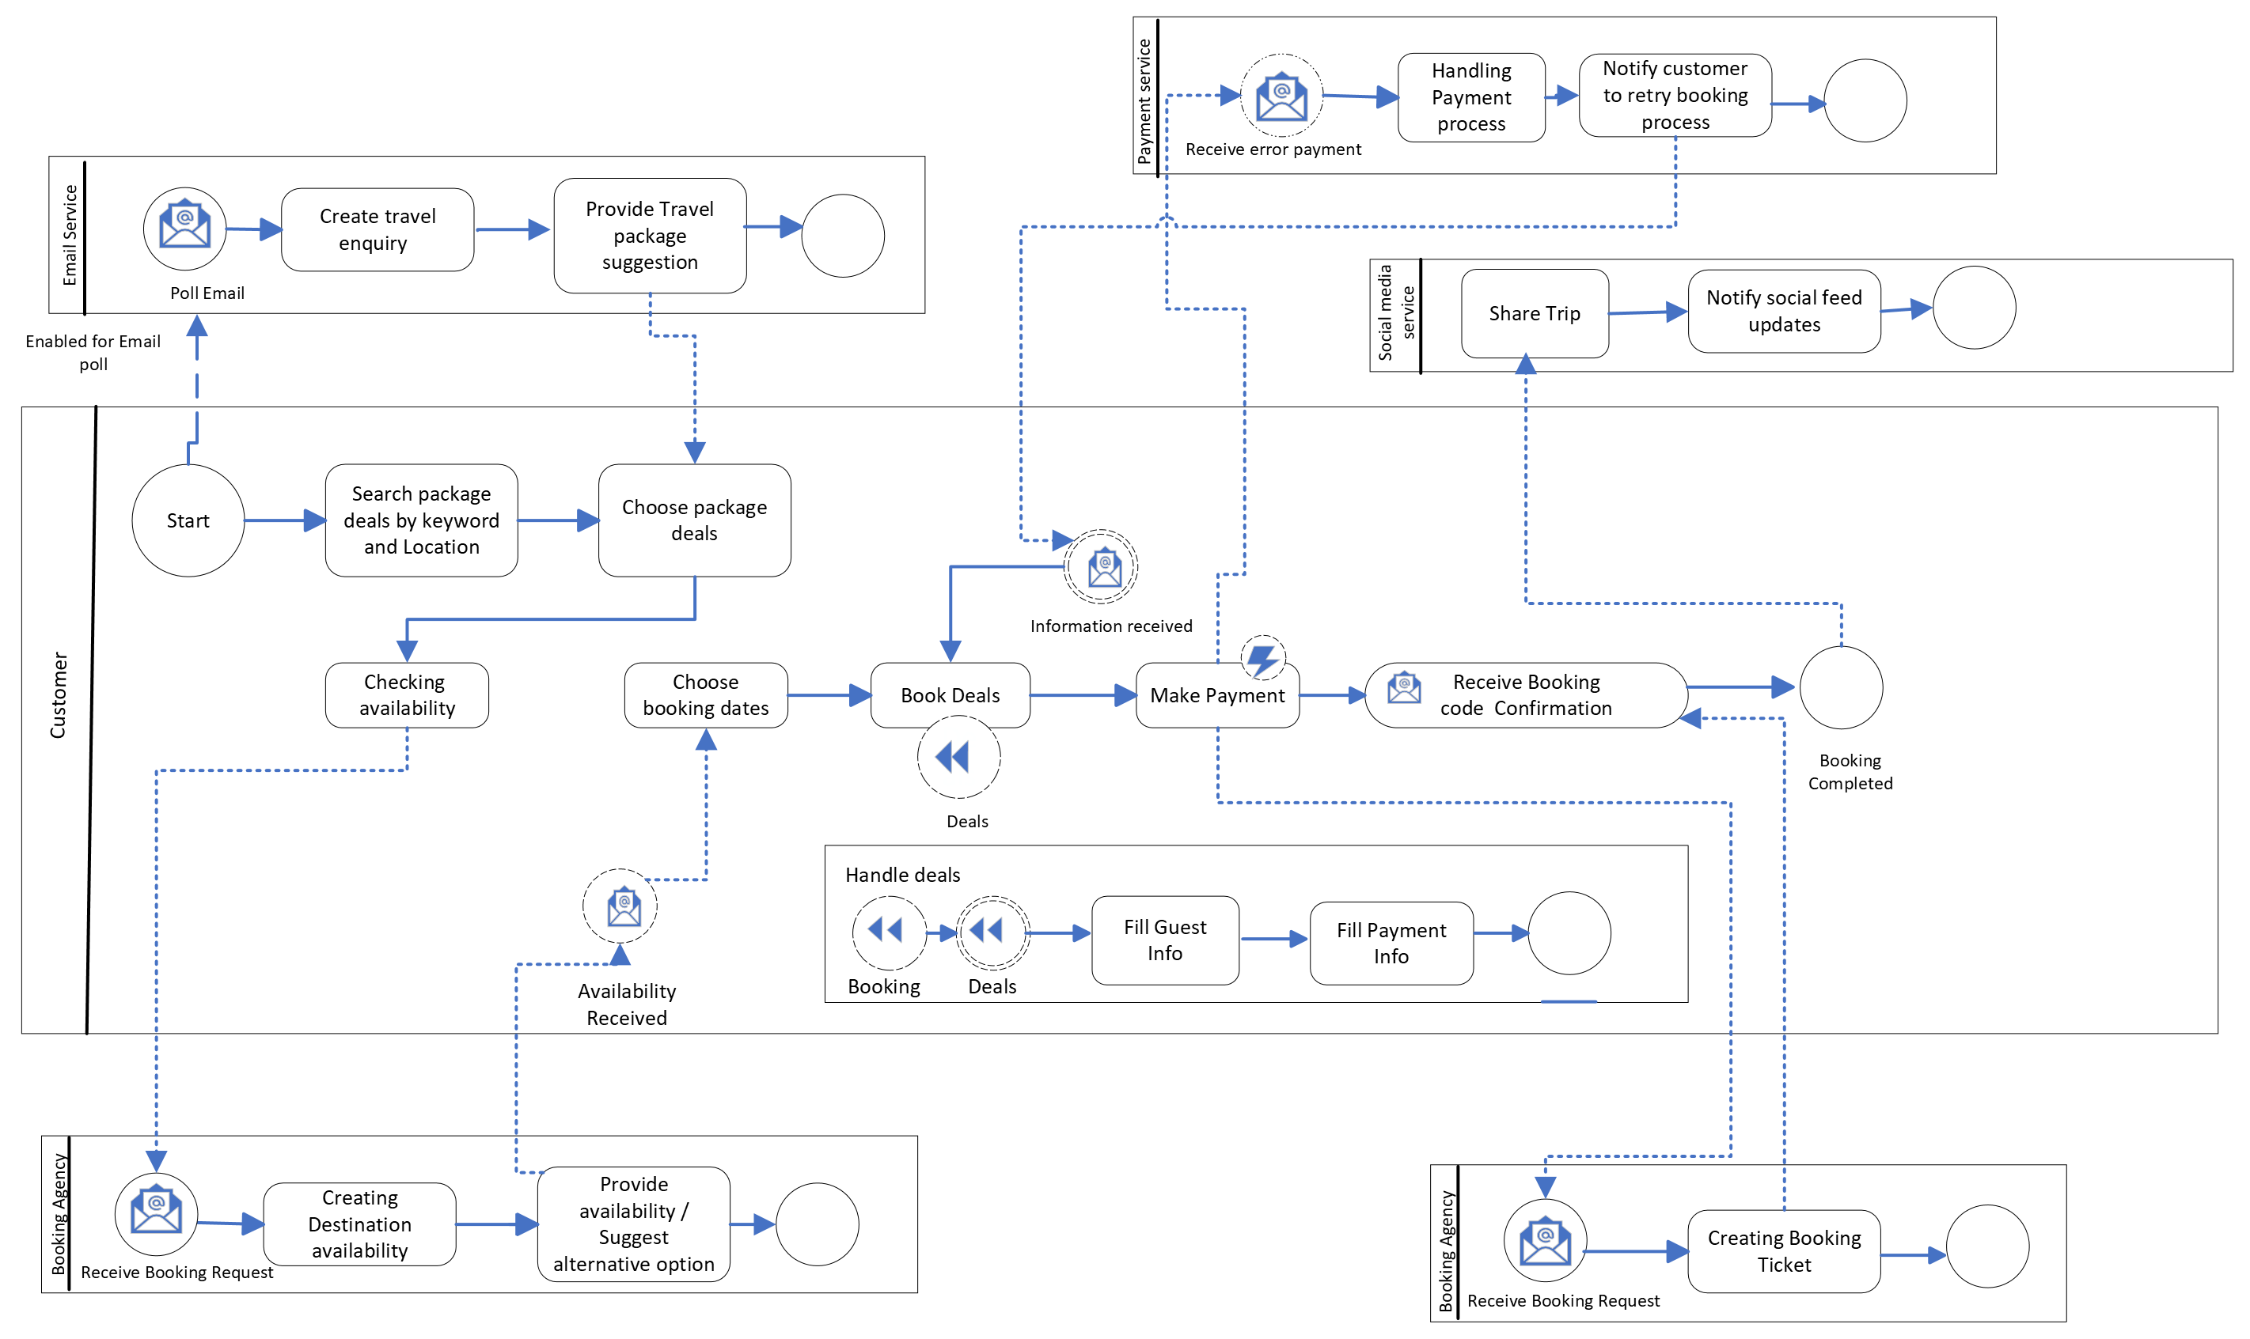
Data flow diagram

Slide 6
Architectural Characteristics
Scalability and Elasticity
Handles peak booking periods and increasing user traffic.
Load balancing to distribute incoming traffic across multiple servers.
Cloud-based services will adapt to changing demands.
Database scaling issues – Use nightly batch to remove and archive older rows (reservations, hotels/flights/cars)
Use caching
For more popular hotels, cache the inventory information. Use database CDC. Whenever inventory changes, cache is invalidated and updated with new inventory
For all hotels/flights/Cars, cache static data like features, hotel details etc.
Performance
Optimized database queries and caching mechanisms to reduce page load time.
Content Delivery Networks (CDNs) to serve static assets quickly.
Reliability and Availability
Redundant fault-tolerant system..
Distributed systems to minimize downtime.
User Experience
User-friendly interface with easy navigation.
Search and filtering options.
Personalized recommendations
Payment Processing:
Secure payment gateways.
Stores payment data securely and follows compliance standards..
Multiple payment options to accommodate user preferences.
Security
Protects user data and payment information with strong encryption.
User authentication (MFA)
Mobile Compatibility
Responsive and mobile-friendly website

Slide 7
Architecture Decision Records (ADR 001)
Title | Choose High-Level Architecture Pattern for Road Warrior app
Status | Proposed
Context | We need to choose a high-level architecture pattern that helps us go to market fast and allows us to make future changes easily.
Decision | We can either go with high-level architecture pattern as a Modular Monolith or Microservices. After doing proper due diligence, we have decided to go with a Microservices based architecture.
Consequences | We will have to deal with some of the complexities that comes with Microservices.

Slide 8
Architecture Decision Records (ADR 002)
Title | Decide on the Microservice Ownership
Status | Proposed
Context | We need to decide on the development teams' structure and how they own/manage the microservices.
Decision | Each team will own one (or more) microservices. A microservice cannot be owned by more than one team. A single team owns decision making responsibility for its microservices and can operate it autonomously within the constraints of the system.
Consequences | Constraining and bounding ownership will help teams move faster but will put added pressure on establishing the right team boundaries. If team boundaries are formed poorly, this will result in an unacceptable level of cross-team coordination.

Slide 9
Architecture Decision Records (ADR 003)
Title | Host Microservices in Microsoft Azure
Status | Proposed
Context | We'll be hosting Microservices in a cloud platform, but we'll need to decide which cloud platform to use.
Decision | We'll use Azure and its managed cloud services for up and running Road Warrior system. We’ve done due diligence with all the major cloud providers and have decided to use Azure.
Consequences | Using Microsoft Azure will result in a significant amount of vendor lock-in. This greatly reduces the portability of the solution. However, using Azure managed services will reduce some of the complexity of the solution.

Slide 10
Architecture Decision Records (ADR 004)
Title | Use Infrastructure as code for deployment
Status | Proposed
Context | We need to decide how infrastructure changes will be made for the shared Microservices platform.
Decision | We'll use the principle of infrastructure as code for all infrastructure changes.
Consequences | No manual infrastructure changes will be allowed. We'll need to invest in Azure DevOps tools and use CHEF/ARM language to treat infrastructure changes as code. There could be a learning curve.

Slide 11

Thank you
GitHub Repo
Team Innovators GitHub Repo
Team Contacts
Biplab Banerjee
Abhijit Gangawane
Sandya Shanmugham
Aravind Aluri
Ragasree Paleti

